Slide 1



DEPARTMENT OF COMPUTER SCIENCE & ENGINEERING
SCHOOL OF COMPUTING
10214CS602 MINOR PROJECT -2 INDUSTRY PROJECTS
WINTER SEMESTER(2023-2024)
REVIEW-1
“X-Ray Analysis of Palm and Fingers for Fracture Detection ”
SUPERVISED BY
PRESENTED BY
Dr. M. Saravana Karthikeyan B.Tech., M.E., M.B.A., Ph. D.,
Assistant professor - SENIOR GRADE
1. BOJJA.YASWANTHKUMARREDDY (VTU23983)(21UEID0500)
2. VIPRAPATANAM.VENKATA RAO (VTU23998)(21UECS0750)
3. MUNDRU SAI SANDEEP (VTU24052)(21UEID0502)

Slide 2
OVERVIEW
ABSTRACT
OBJECTIVES
TIMELINE OF THE PROJECT
INTRODUCTION
LITERATURE REVIEW
DESIGN AND METHODOLOGIES
IMPLEMENTATION
CONCLUSION
REFERENCES

Slide 3
ABSTRACT
A Novel approach for fracture diagnosis in the palm and fingers that combines artificial intelligence (AI) and Augmented Reality (AR). Traditional approaches for detecting fractures in hand X-rays are subjective and time-consuming.
Our solution intends to address these problems by automating fracture identification using deep learning techniques and displaying the results in an intuitive augmented reality environment. Medical personnel can use AI and AR technologies to observe and interact with fracture information overlaid on realistic hand models in real time.
The combination of AI and augmented reality not only improves fracture detection precision, but also changes the way doctors interact with diagnostic imaging, resulting in higher diagnostic accuracy, faster processes, and, ultimately, better patient outcomes.

Slide 4
OBJECTIVES
AIM OF THE PROJECT:
The aim of the project on X-ray analysis of the palm and fingers for fracture detection is to develop an efficient and accurate diagnostic methodology for identifying and assessing fractures in the bones of the hand.
This includes utilizing advanced imaging techniques to capture clear images of the palm and fingers, conducting detailed analyses to detect fractures, and correlating findings with clinical presentations to confirm diagnoses.
The project seeks to enhance the accuracy and reliability of fracture detection in the hand, improve patient outcomes through appropriate and timely treatment, and provide a foundation for future advancements in diagnostic imaging of hand injuries.
SCOPE OF THE PROJECT :
The scope of the project on X-ray analysis of the palm and fingers for fracture detection encompasses a comprehensive approach to diagnosing and evaluating hand injuries
It includes optimizing imaging protocols to obtain clear and consistent X-ray images from various angles, such as anteroposterior, oblique, and lateral views.
he project aims to establish methods for detecting and classifying different types of fractures, including transverse, oblique, spiral, comminuted, and hairline fractures, as well as assessing soft tissue damage and joint involvement.
Advanced imaging techniques, such as digital X-rays and 3D reconstruction, may be explored to enhance visualization and analysis.

Slide 5
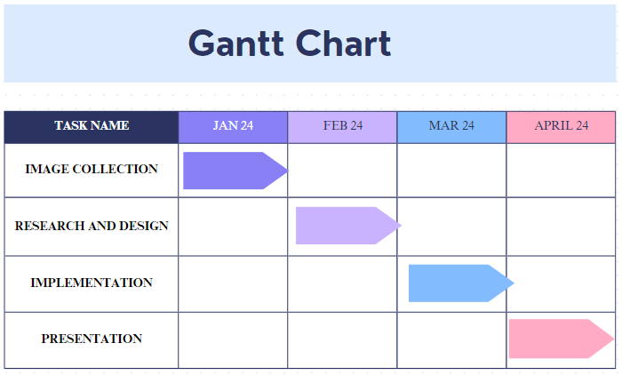
TIMELINE OF THE PROJECT

Slide 6
INTRODUCTION
Fractures in the hand's bones, particularly the palm and fingers, are common injuries that can have a substantial impact on a person's everyday life and functionality. Accurate and quick diagnosis of these fractures is critical for adequate treatment and good rehabilitation.
Traditional fracture detection procedures, such as eye examination and manual interpretation of X-ray images by radiologists, are time-consuming and subjective, potentially leading to errors or delays in diagnosis.
The process of creating and training a Deep Learning model for fracture detection with frameworks such as TensorFlow or PyTorch.
The system intends to provide medical professionals with a dependable tool for rapid diagnosis and treatment planning by leveraging the capabilities of modern machine learning algorithms.
Fracture identification precision and efficiency by combining cutting-edge technology such as convolutional neural networks (CNNs) and image processing approaches, thereby enhancing patient care results.
Seamlessly Integration with augmented reality(AR) Technology to improve medical professionals' diagnostic capabilities. By combining the strengths of AI and augmented reality, our system seeks to create an intuitive and immersive platform for fracture diagnosis, allowing doctors to visualize and interact with X-ray images in three dimensions.

Slide 7
LITERATURE REVIEW
Author’s Name | Paper name and publication details | Year of publication | Main content of the paper
R. S. Prihatini | Proc. - 2020 IEEE 9th Int. Conf. Commun. Syst. Netw. Technol. CSNT | 2020 | Texture analysis and fracture identification of lower extremity bones X-ray images
L. Nascimento | Int. Conf. Electr. Eng. Comput. Sci. Informatics, vol. | 2015 | Computer aided bone fracture identification based on ultrasound images
R. Bagaria | Proc. - 2015 IEEE 4th Port. Meet. Bioeng. ENBENG | 2018 | Different techniques for identification of a bone fracture in analysis of medical image
L. Wang | Proc. - Int. Symp. Biomed. Imaging, vol. | 2019 | Automatic recognition of pertrochanteric bone fractures in femur using level sets

Slide 8
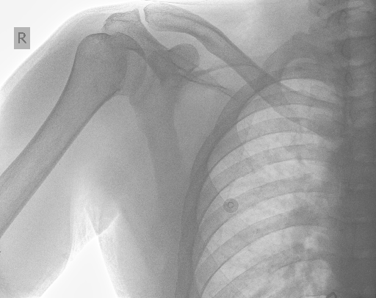
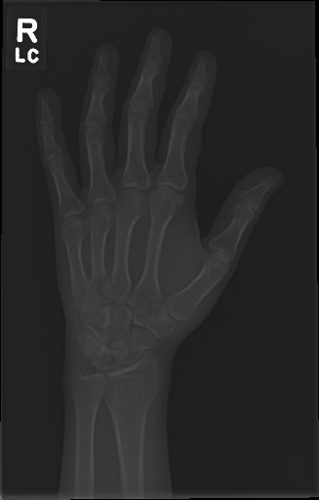
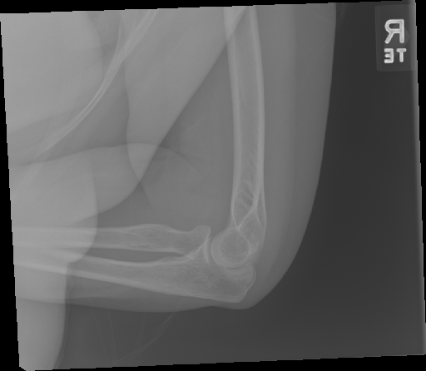
MODULE 1:DATA COLLECTION AND MANIPULATION
Step:1 Collection of data

Slide 9
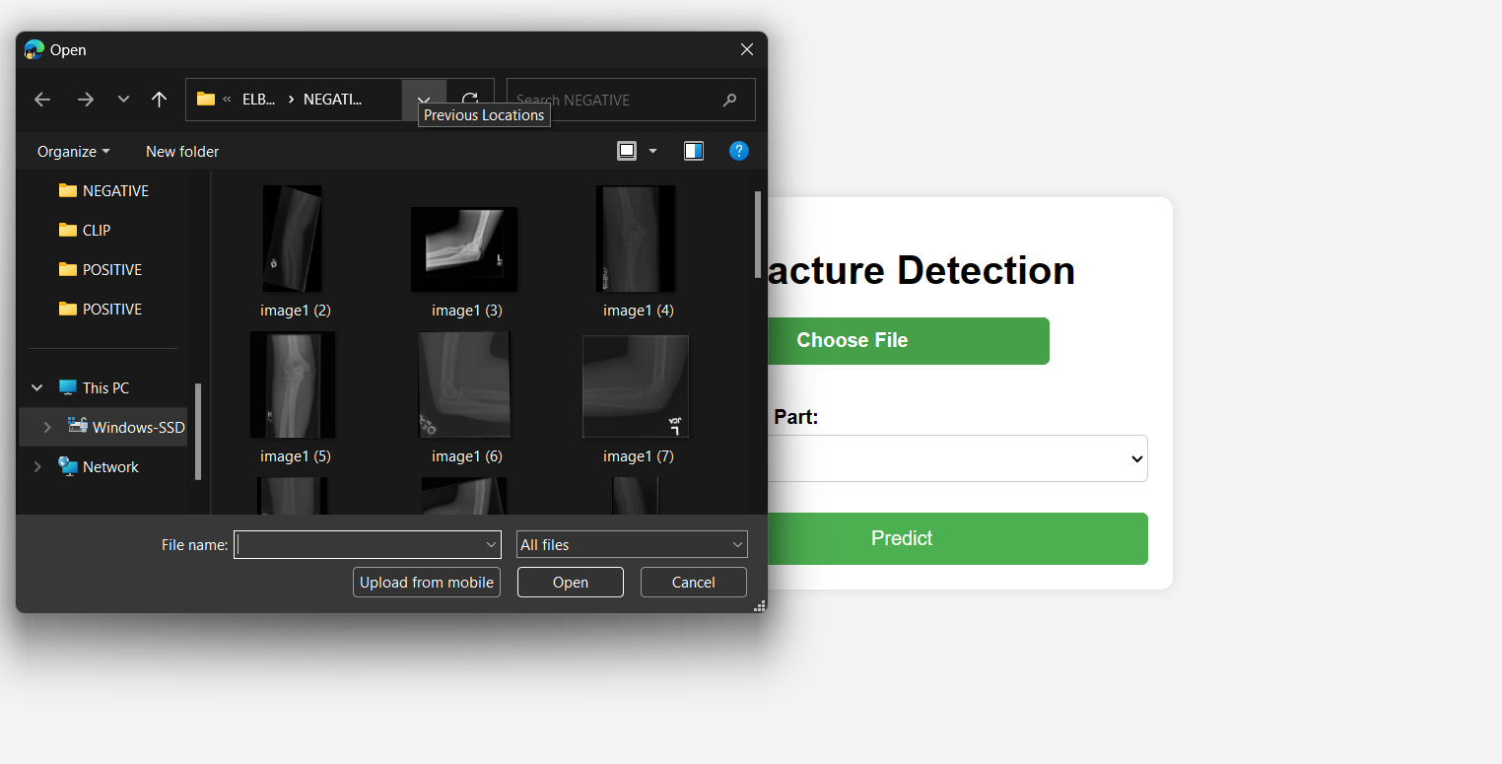
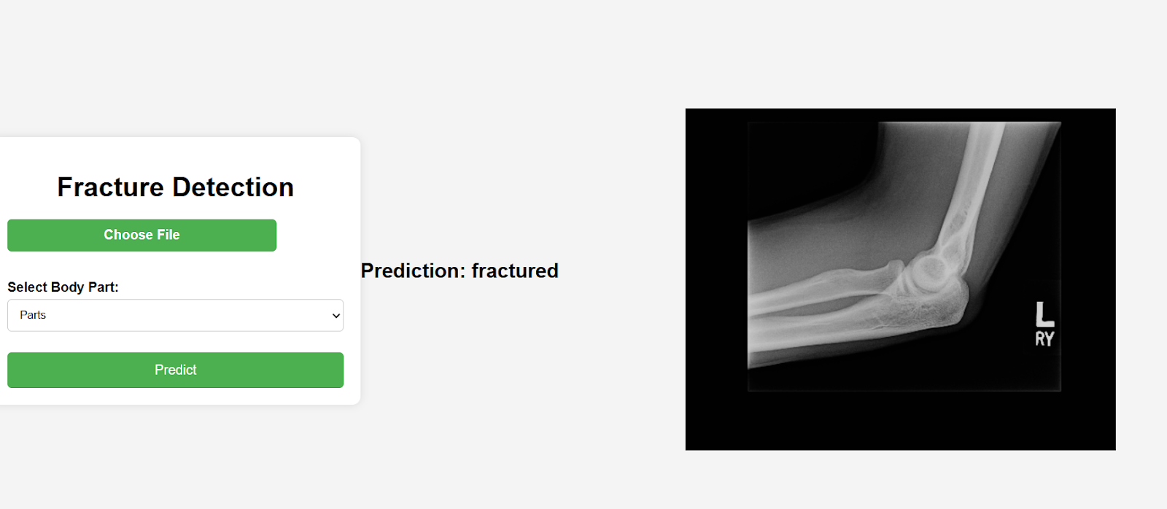
Step 2: Processing the data

Slide 10
Module 2- Convolutional Neural Networks(CNNs) algorithm
Convolution Neural Network (CNN) is especially valuable for spatial information examination, picture acknowledgment, PC vision, characteristic language handling, signal preparing, and an assortment of other various purposes.
They are organically inspired by the working of neurons in the visual cortex to a visual upgrade. What makes CNN significantly more impressive contrasted with the other criticism forward organizations for picture acknowledgment is the way that they don't need as much human mediation and boundaries as a portion of different organizations, for example, MLP do.
CNNs are trained by gradient-based optimization techniques like backpropagation, which iteratively adjusts the network parameters (weights and biases) to minimize a predetermined loss function. During training, the network learns to extract key features from incoming data and generate accurate predictions about previously unseen samples.
This is principally determined by the way that CNN's have neurons organized in three measurements. CNN's make the entirety of this sorcery occur by taking a bunch of info and giving it to at least one of the accompanying fundamental concealed layers in an organization
Convolution Layers
Pooling Layers
Fully Connected Layers

Slide 11
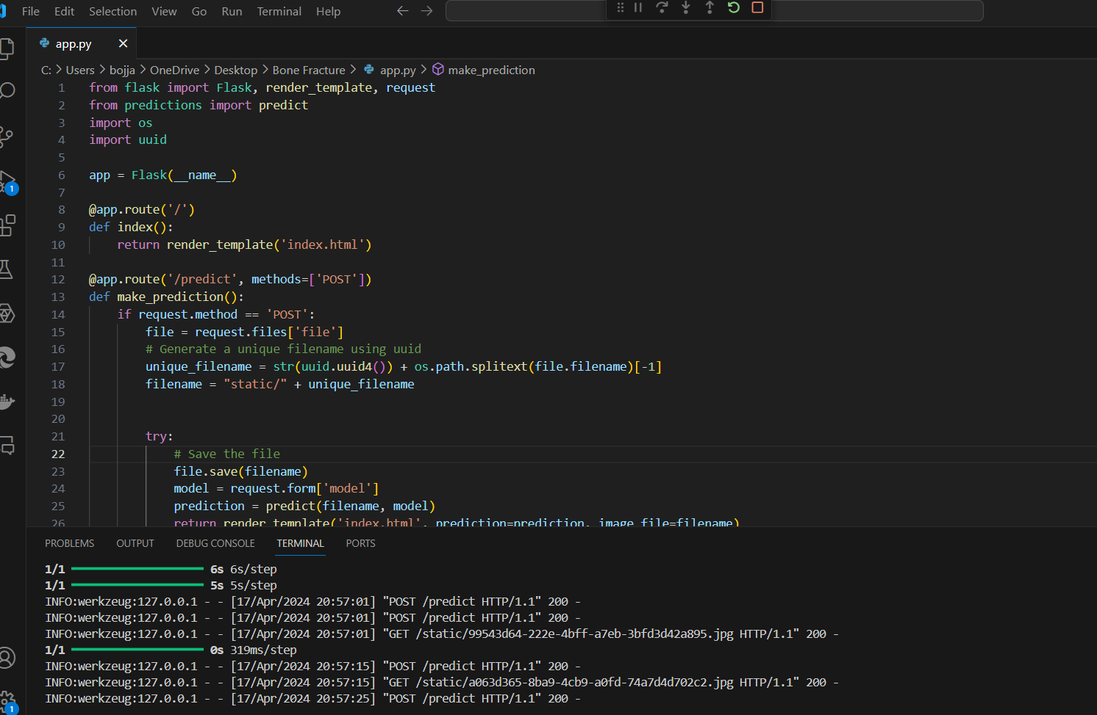
Step 3: Using Convolutional Neural Networks(CNNs) algorithm

Slide 12
Step 4: The output
After uploading a hand X-ray image to the system, the deep learning model examines it and automatically detects any fractures in the palm and fingers.

Slide 13
IMPLEMENTATION
Architecture Diagram
Data –Flow Diagram
Use Case Diagram
Class Diagram
Activity Diagram
Sequence Diagram
Collaboration Diagram(If applicable)
E-R Diagram

Slide 14
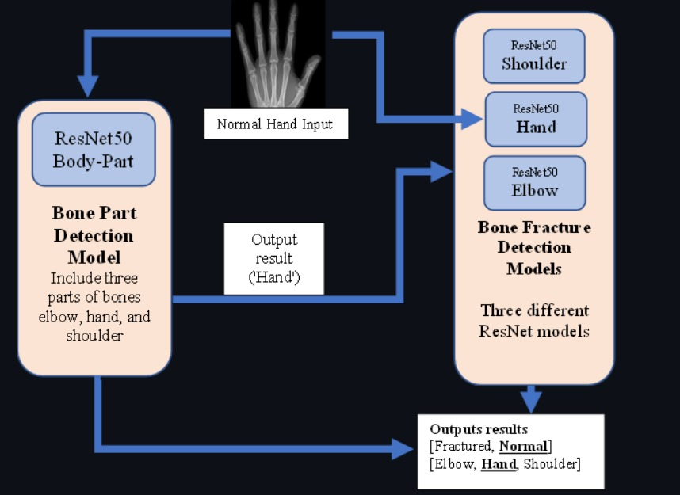
Architecture Diagram
The sequential flow of information across many levels. Raw input data, such as photographs, is fed into the network first, via the Input Layer. The Convolutional Layers extract features from this data, which is then transformed nonlinearly using Activation Functions. Pooling Layers then downsample the feature maps while keeping critical information.
The processed data is then sent into Fully Connected Layers for classification or regression tasks. Finally, the output layer generates the network's predictions. This graphic depicts how input data is gradually changed and processed by the CNN's layers, ultimately resulting in correct predictions or outputs.

Slide 15
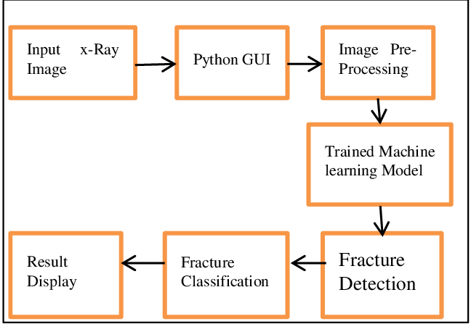
Data –Flow Diagram
A data flow diagram (DFD) for fracture detection outlines the sequence and processing of data in a system designed to detect fractures in a specific object, such as bones in medical imaging. The system begins with acquiring sensor data from various imaging modalities such as X-ray.
Once the data is collected, it undergoes preprocessing to improve quality and enhance features for analysis, including noise reduction and contrast enhancement. The enhanced image data is then analyzed using image segmentation and feature detection techniques to identify potential fractures and classify them based on type and severity.
This analysis informs the generation of comprehensive reports that provide detailed insights into detected fractures, including their locations and characteristics.

Slide 16
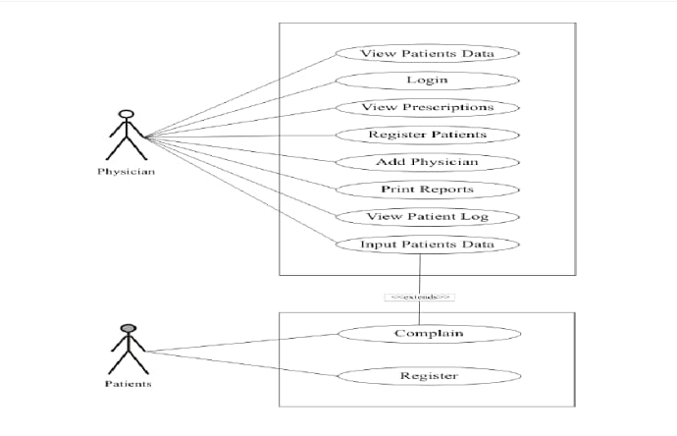
Use Case Diagram
A use case diagram for fracture detection presents the interactions between users (actors) and the system to achieve specific objectives in identifying fractures. In this context, actors typically include radiologists, medical technicians, and sometimes patients.
The use case diagram illustrates key functions such as capturing imaging data, where medical technicians operate imaging equipment to obtain X-ray, CT, or MRI scans of the area of interest.
Radiologists can then interact with the system to analyze preprocessed images, identifying potential fractures using advanced image analysis tools. Another important use case involves generating a comprehensive report for medical professionals, detailing the location, severity, and type of detected fractures, along with recommended courses of action.
Additionally, the system may provide real-time alerts or notifications to radiologists or medical teams if critical fractures are detected. Patients may also be involved indirectly through receiving information or alerts about their medical status.

Slide 17
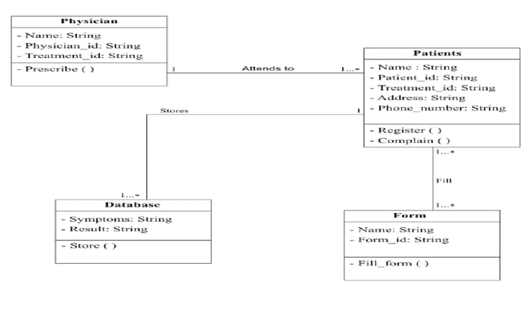
Class Diagram
A class diagram for fracture detection in medical imaging systems outlines the structural relationships between different classes and their attributes and methods in the context of identifying fractures. Core classes in the system may include ImageData, representing medical images such as X-rays, MRI scans, or CT scans, and encapsulating attributes such as image quality and resolution.
The Fracture class stores information about detected fractures, including location, type, and severity. The Patient class contains patient-specific data, such as medical history, age, and gender, which can influence the detection and analysis process.
To support fracture detection, the system includes classes such as ImageProcessor, which offers methods to preprocess images (e.g., noise reduction, enhancement) and segment potential areas of interest
The FractureDetector class provides methods to analyze preprocessed images and identify fracture characteristics.

Slide 18
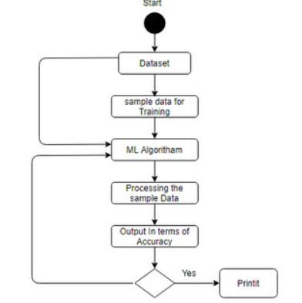
Activity Diagram
An activity diagram for fracture detection in a medical imaging system outlines the sequential workflow and decision-making processes involved in identifying fractures.
The diagram begins with obtaining medical imaging data such as X-rays, MRI, or CT scans from the patient. These images are then preprocessed to enhance quality and remove noise, ensuring optimal conditions for analysis.
Once preprocessing is complete, the enhanced images proceed to the analysis stage, where advanced algorithms or trained radiologists examine the images for signs of fractures.
This involves segmentation of the image to identify potential areas of interest, followed by fracture feature extraction and classification based on type and severity.
If fractures are detected, the activity flow branches depending on the severity and location. For critical fractures, the system triggers alerts to notify healthcare providers for immediate attention.
Simultaneously, the detected fractures and their characteristics, along with relevant patient data, are compiled into a comprehensive diagnostic report.

Slide 19
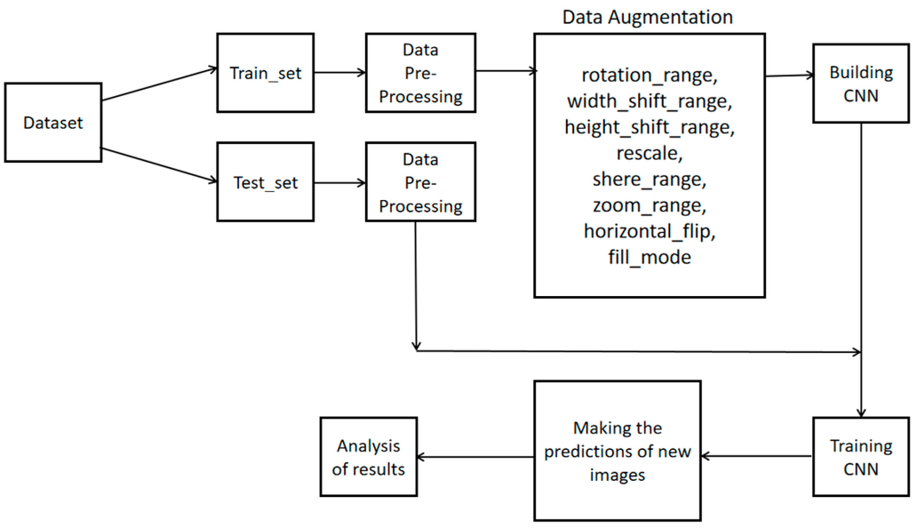
Sequence Diagram
A sequence diagram for fracture detection illustrates the interactions between various components in the system and their chronological sequence when identifying fractures in medical imaging data. It begins with a medical imaging device (such as an X-ray, MRI, or CT scanner) capturing images of the patient's area of interest.
The images are then sent to the system's ImageProcessor component, which preprocesses them to improve quality and enhance features, such as removing noise and adjusting contrast.Next, the preprocessed images are passed to the FractureDetector component, which applies image analysis algorithms to identify potential fractures.
This process involves segmenting the image, detecting fracture features, and classifying the findings based on type and severity. If fractures are detected, the system may route critical fracture information to the AlertSystem component, which notifies healthcare providers of urgent cases requiring immediate attention.
Simultaneously, the detected fractures and their details, such as location and severity, are sent to the ReportGenerator component.

Slide 20
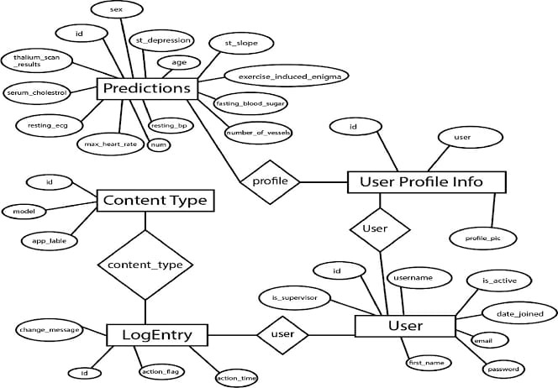
E-R Diagram
An Entity-Relationship (ER) diagram for fracture detection could include entities such as "Patient," "X-Ray Image," "Fracture," and "Physician." The relationships between these entities could be represented as "Patient undergoes X-Ray," "X-Ray Image detects Fracture," and "Physician diagnoses Fracture." Attributes for each entity would include details like patient ID, X-Ray image ID, fracture location, and physician ID. This structure helps visualize how data flows within the fracture detection process.

Slide 21
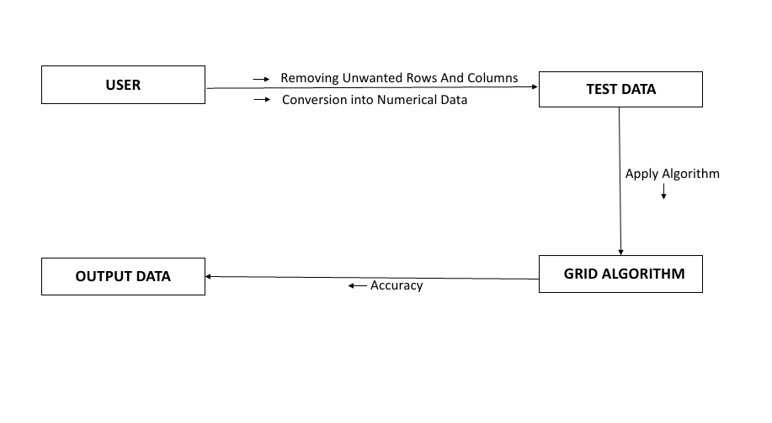
Collaboration Diagram(If applicable)
A collaboration diagram for fracture detection would illustrate the interactions between various components involved in the process. It could depict entities such as "Patient," "Radiology Department," "Fracture Detection Algorithm," and "Physician." The diagram would show the flow of information and actions, such as the patient undergoing an X-Ray.
The X-Ray image being processed by the Fracture Detection Algorithm, and the results being reviewed and diagnosed by the Physician. Each component's responsibilities and interactions would be clearly delineated, aiding in the understanding of the fracture detection workflow.

Slide 22
REFERENCES
[1] R. Bagaria, S. Wadhwani, and A. K. Wadhwani, “Different techniques for identification of a bone fracture in analysis of medical image,” Proc. - 2020 IEEE 9th Int. Conf. Commun. Syst. Netw. Technol. CSNT 2020, pp. 327–332, 2020, doi: 10.1109/CSNT48778.2020.9115760.
[2] R. S. Prihatini, A. H. Setyaningrum, and I. M. Shofi, “Texture analysis and fracture identification of lower extremity bones X-ray images,” Int. Conf. Electr. Eng. Comput. Sci. Informatics, vol. 2017-December, no. September, pp. 19–21, 2017, doi: 10.1109/EECSI.2017.8239113.
[3] L. Nascimento and M. G. Ruano, “Computer aided bone fracture identification based on ultrasound images,” Proc. - 2015 IEEE 4th Port. Meet. Bioeng. ENBENG 2015, no. February, pp. 26–28, 2015, doi: 10.1109/ENBENG.2015.7088892.
[4] Y. Cao, H. Wang, M. Moradi, P. Prasanna, and T. F. Syeda-Mahmood, “Fracture detection in x-ray images through stacked random forests feature fusion,” Proc. - Int. Symp. Biomed. Imaging, vol. 2015-July, pp. 801–805, 2015, doi: 10.1109/ISBI.2015.7163993.
[5] L. Wang, H. Cheng, H. Lan, Y. Zheng, and K. Li, “Automatic recognition of pertrochanteric bone fractures in femur using level sets,” Proc. Annu. Int. Conf. IEEE Eng. Med. Biol. Soc. EMBS, vol. 2016-October, pp. 3851–3854, 2016, doi: 10.1109/EMBC.2016.7591568.
[6]V. L. F. Lum, W. K. Leow, Y. Chen, T. Sen Howe, and M. A. Png, “Combining classifiers for bone fracture detection in x-ray images,” Proc. - Int. Conf. Image Process. ICIP, vol. 1, pp. 1149–1152, 2005, doi: 10.1109/ICIP.2005.1529959.

Slide 23
THANK YOU

